Slide 1
Testing IRM Godrej Lottemart Ps.Rebo
20 Juli 2023

Slide 2
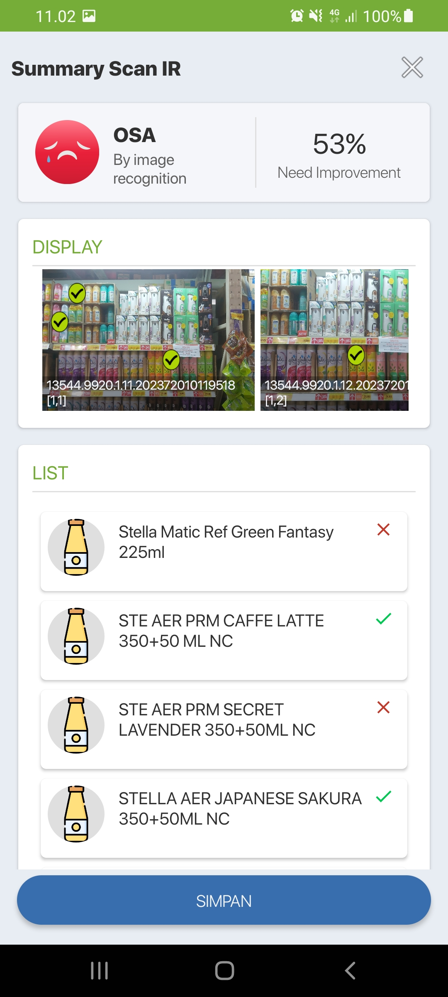
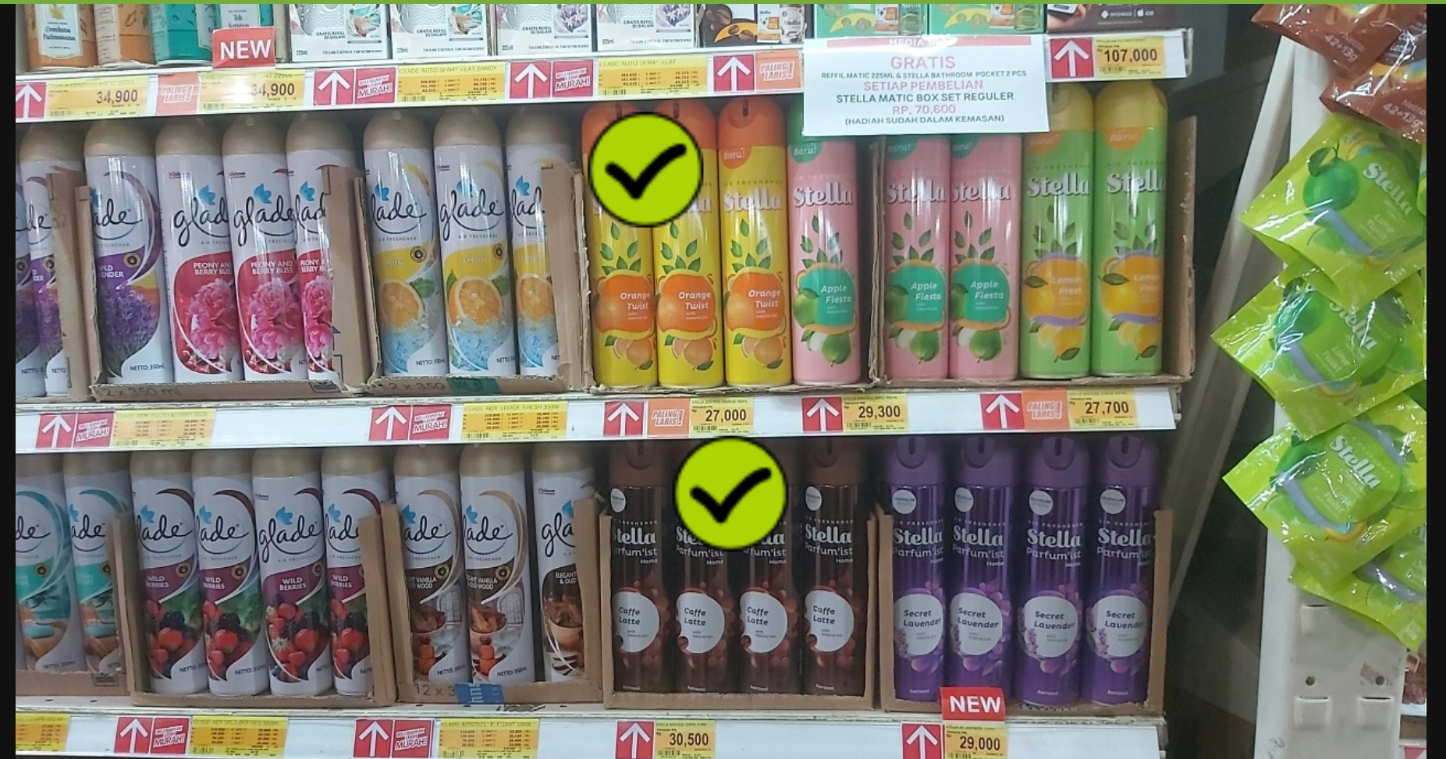
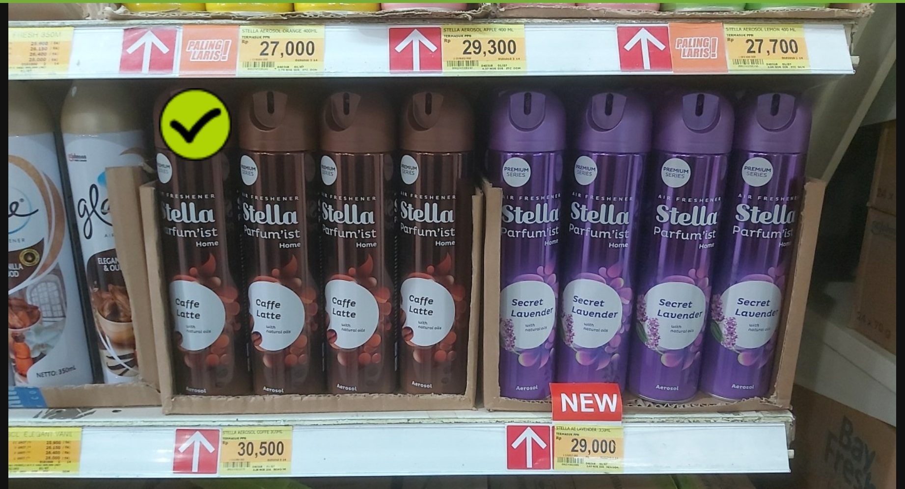
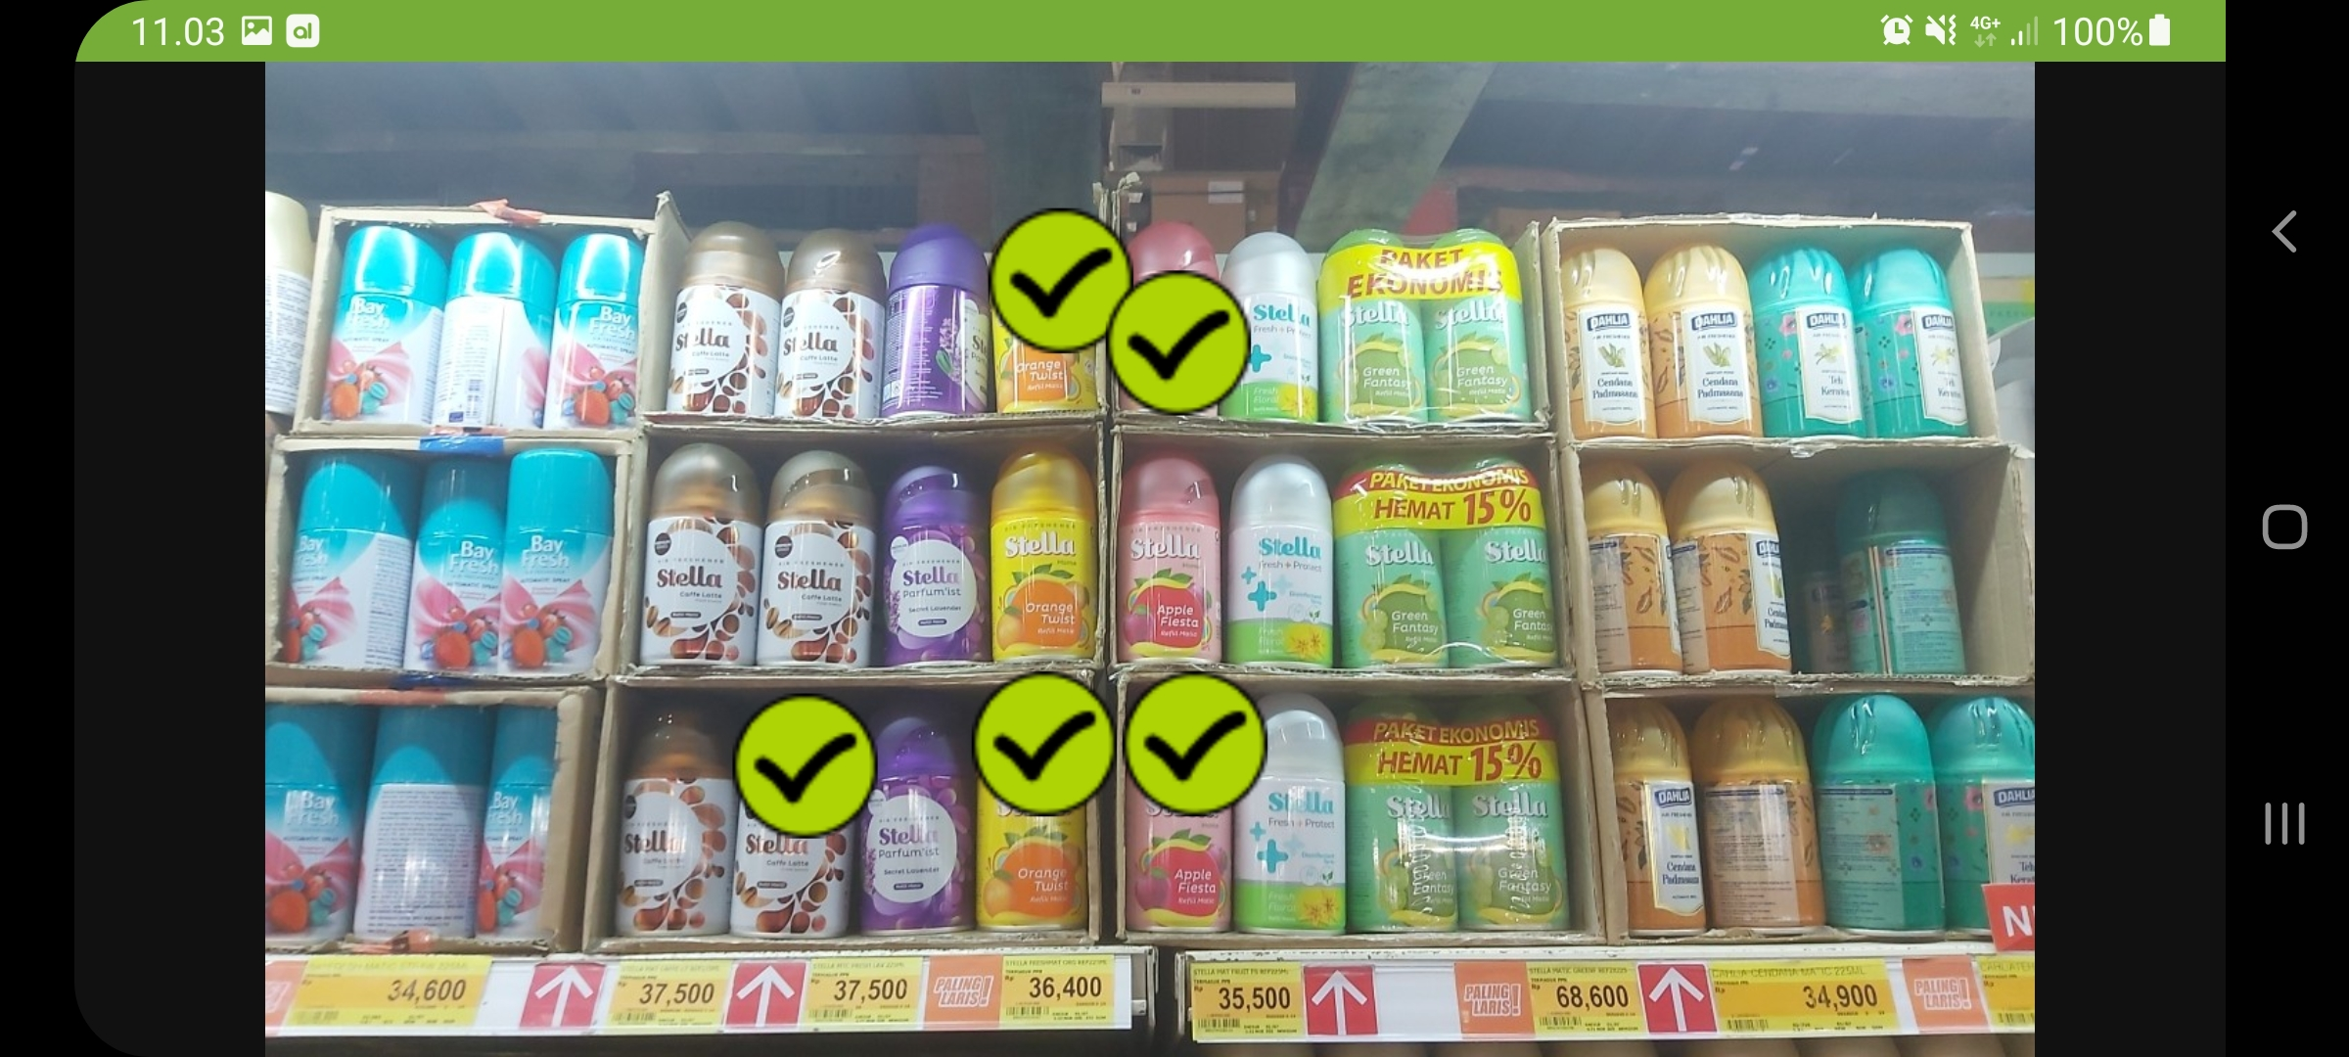
RESULT :
STE AER PRM CAFFE LATTE 350+50 ML NC (detected)
STELLA AEROSOL ORANGE 400 ML NC (detected)
Ste Mtc Ref PrmCaffe.Lat 225mL (Detected)
ISSUES:
STE AER PRM SECRET LAVENDER 350+50ML NC (NOT DETECTED)
STELLA AEROSOL APPLE 400 ML NC (Not Detected)
STELLA AEROSOL LEMON 400 ML NC (Not Detected)
STELLA AER JAPANESE SAKURA 350+50ML NC -- pada list sku detected, namun pada foto tidak terdapat sku tersebut
STELLA AEROSOL ORANGE 400 ML NC -- pada Foto terdeteksi, namun pada list sku terceklis di uku

Slide 3
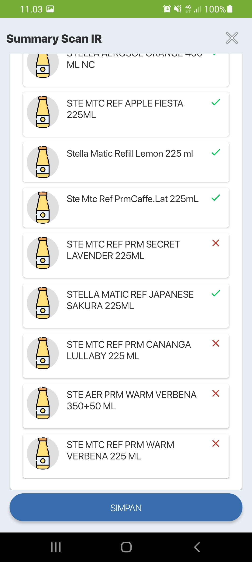
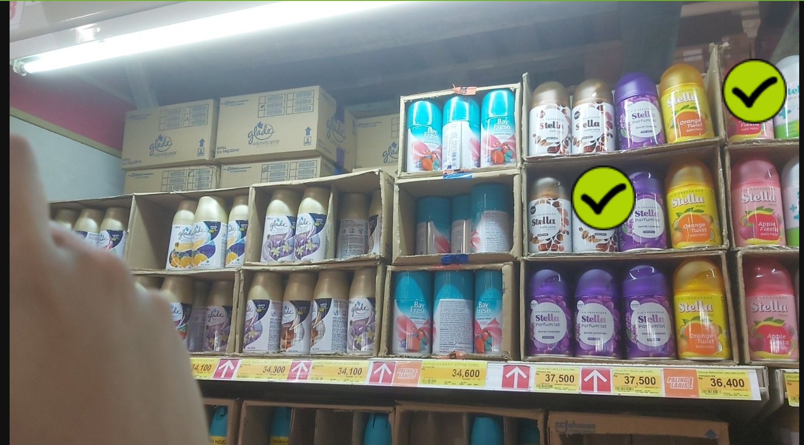
RESULT :
STE AER PRM CAFFE LATTE 350+50 ML NC (Detected)
STE MTC REF APPLE FIESTA 225ML 225 (Detected)
Ste Mtc Ref PrmCaffe.Lat 225mL (Detected)
ISSUES:
STE AER PRM SECRET LAVENDER 350+50ML NC (NOT DETECTED)
STE MTC REF PRM SECRET LAVENDER 225ML (Not Detected)
STELLA AER JAPANESE SAKURA 225ml -- pada list sku detected, tapi pada foto tidak terdapat sku tersebut
Stella Matic Refill Lemon 225ml -- pada list sku detected, tapi pada foto tidak terdapat sku tersebut
Stella Matic Refill SB Orange 225 ml -- pada list sku tidak ada, tapi pada foto sku tersebut terdeteksi

Slide 4
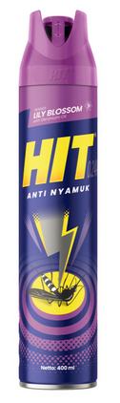
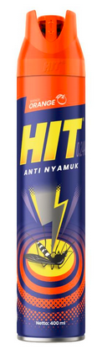
Pada Category Insecticide
semua kemasan baru, terdapat
2 sku orange dan lily blossom
400ml
RESULT :
ISSUES:
Hit Aerosol Orange 400ml (Not Detected)
Hit Aerosol Lily Blossom 400 ml (Not Detected)

Slide 5
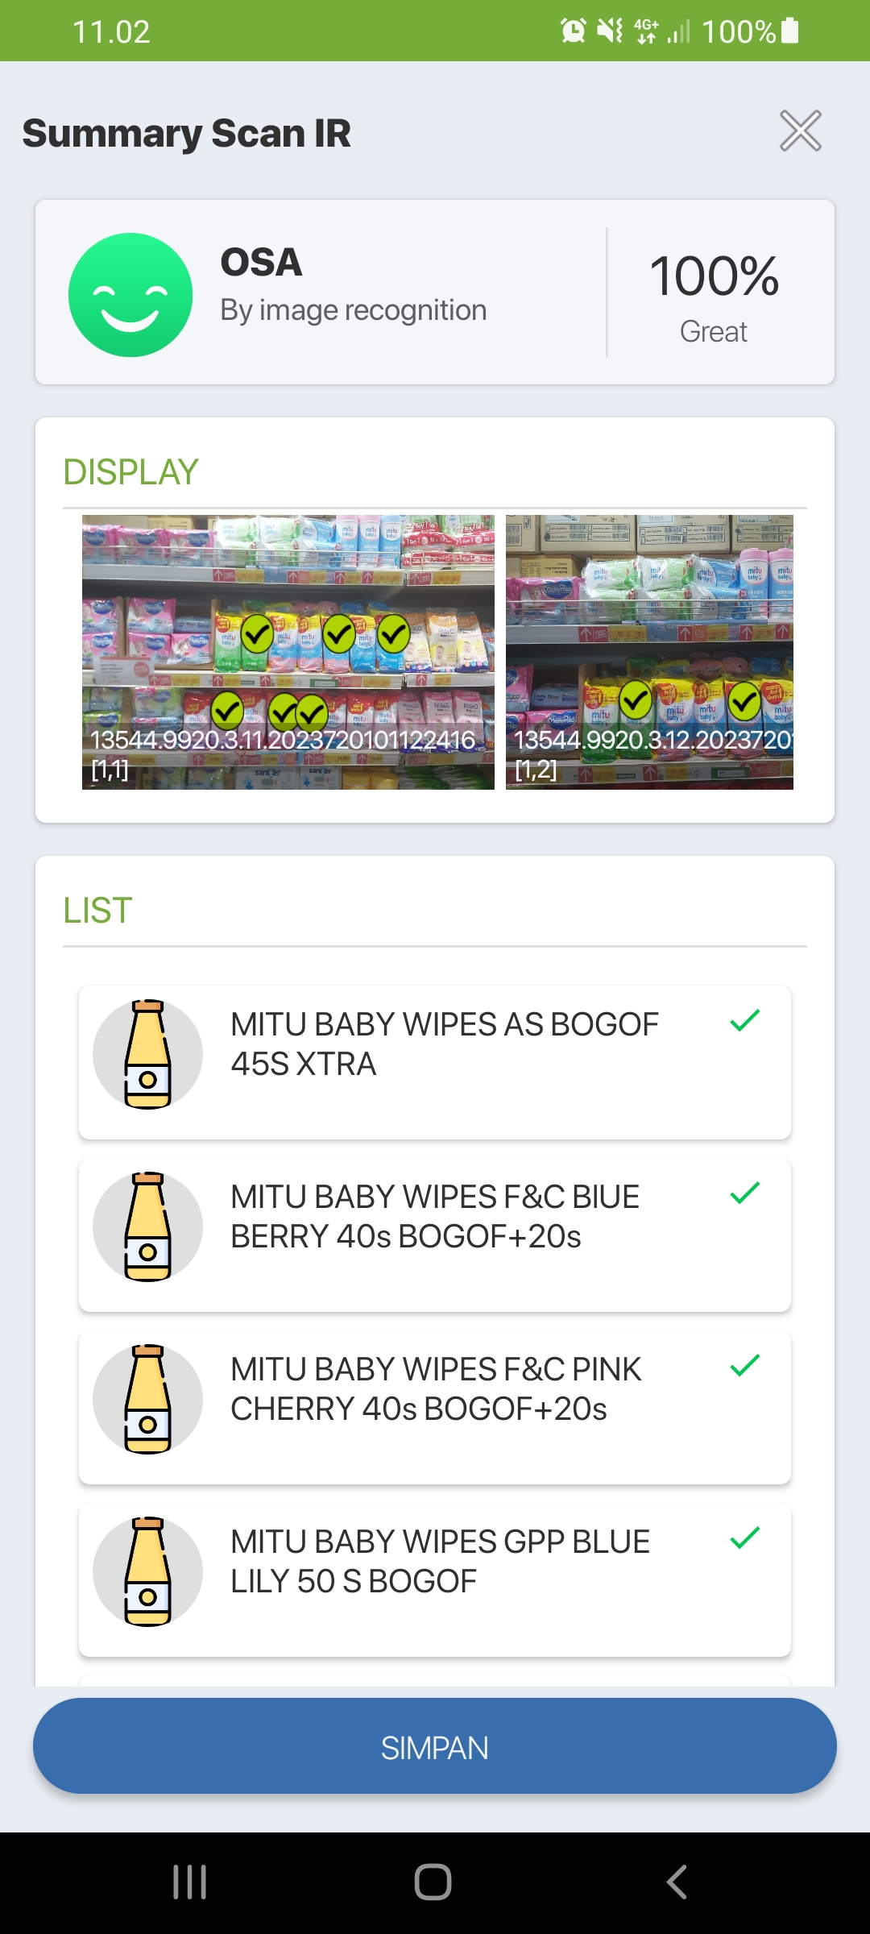
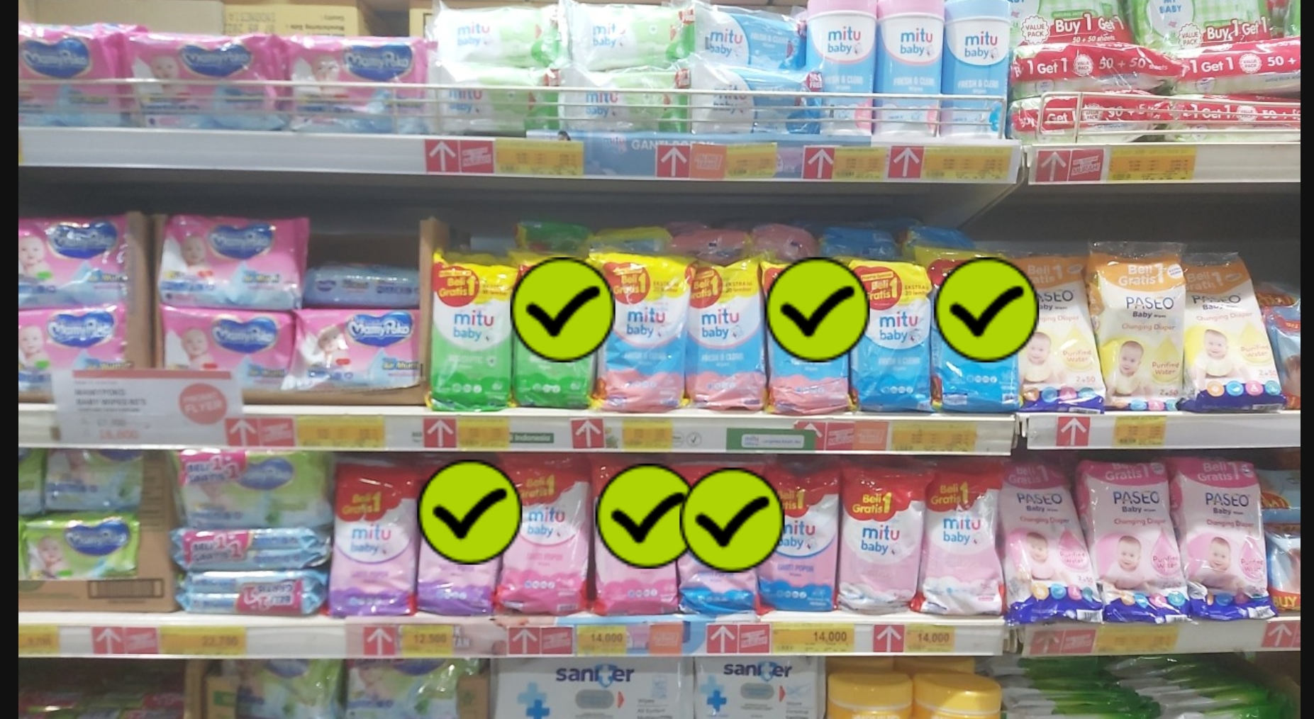
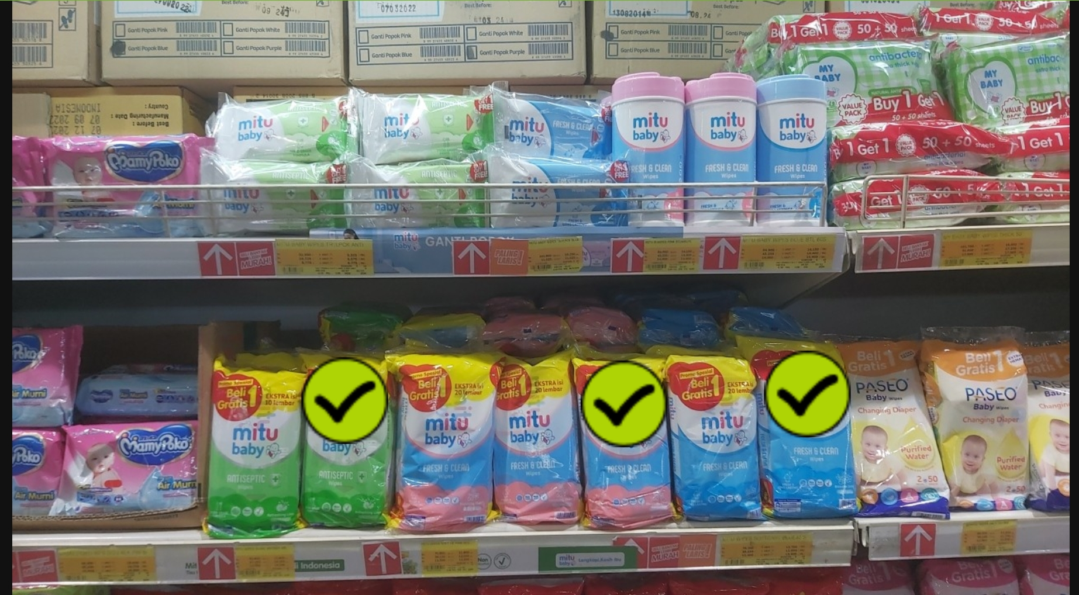
RESULT :
MITU BABY WIPES AS BOGOF 45’S XTRA (detected)
MITU BABY WIPES GPP PURPLE FR 50 S BOGOF (detected)
MITU BABY WIPES F&C BlUE BERRY 40s BOGOF+20s (detected)
MITU BABY WIPES F&C PINK CHERRY 40s BOGOF+20s (detected)
MITU BABY WIPES GPP PINK ROSE 50 S BOGOF (detected)
MITU BABY WIPES GPP BLUE LILY 50 S BOGOF (detected)
ISSUES:

Slide 6
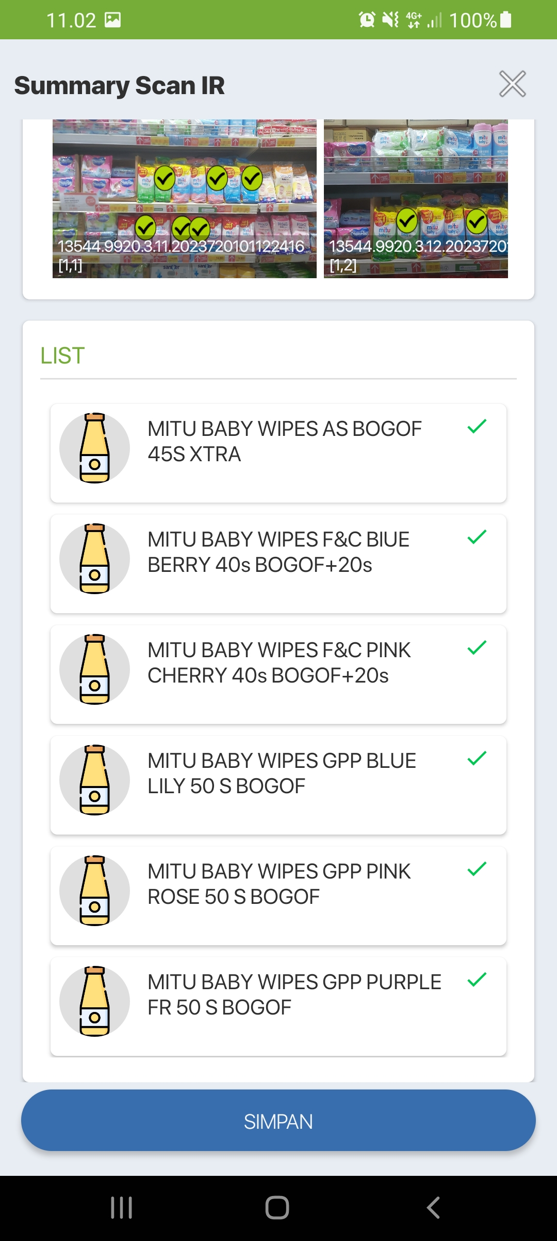
RESULT :
MITU BABY WIPES AS BOGOF 45’S XTRA (detected)
MITU BABY WIPES GPP PURPLE FR 50 S BOGOF (detected)
MITU BABY WIPES F&C BlUE BERRY 40s BOGOF+20s (detected)
MITU BABY WIPES F&C PINK CHERRY 40s BOGOF+20s (detected)
MITU BABY WIPES GPP PINK ROSE 50 S BOGOF (detected)
MITU BABY WIPES GPP BLUE LILY 50 S BOGOF (detected)
ISSUES:

